Slide 1
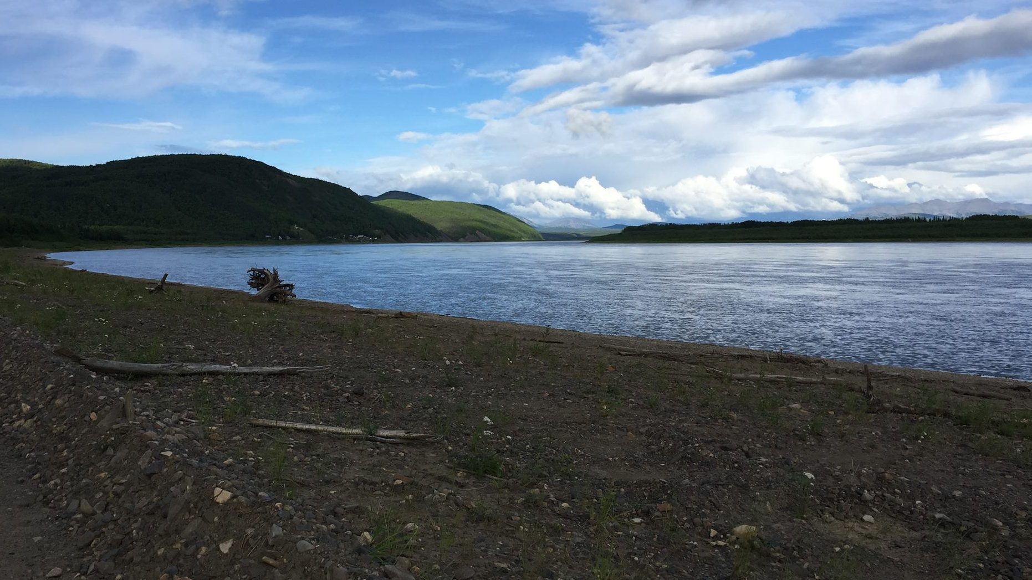
NATIVE VILLAGE OF NAPAIMUTE
What is Brownfields
Contaminants in Alaska
Benefits of Redevelopment
How can we assist
State Inventory list
Contact us
BROWNFIELDS TRIBAL RESPONSE PROGRAM

Slide 2
WHAT IS A BROWNFIELD
EXAMPLES OF BROWNFIELDS
Old Mine Sites
Dump Sites
Military Sites
Abandoned Tank Farms
Buildings that may have stored controlled substances
As defined by The Environmental Protection Agency (EPA), Real property where expansion, redevelopment, or reuse of the property may be complicated by the presence or the potential presence of hazardous substance, pollutant, or contaminant.

Slide 3
SUBSTANCES THAT MAYBE PRESENT IN ALASKA
Gasoline
Diesel
Asbestos
Lead
PCBs
Mercury
Pesticides
Many other contaminants

Slide 4
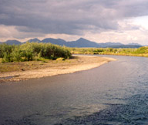
BENEFITS OF REDEVELOPMENT
Protect human health and environment
Increase property value
Reuse existing infrastructure
Improve quality of life
Wildlife habitat rehabilitation
Historic Preservation
Economic Development
Community Development

Slide 5
HOW WE CAN HELP
Be a resource- Inventory potential sites
Educate- Help assist with training for response as needed, Perform community outreach on Brownfields
Assist- prioritize sites for possible clean up

Slide 6
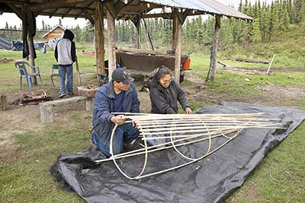
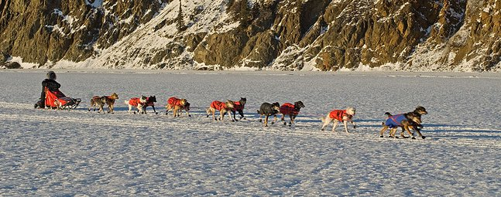
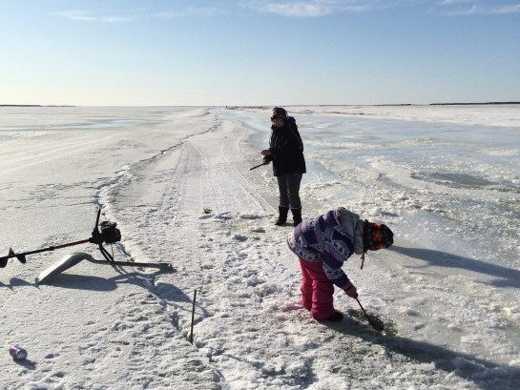
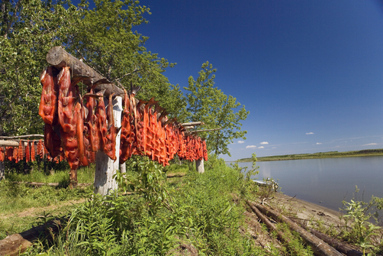
DO YOU HAVE INFORMATION FOR POSSIBLE SITES TO BE ADDED TO OUR INVENTORY LIST?
With your help and knowledge, we will be able to gather information about old sites in our area. It is important to help keep our lands clean and our traditional way of life sustainable for the future.
Contact:
Brownfields Coordinator
Joe Kameroff JR
PO Box 107
Aniak, AK 99557 (907)675-4388 Napaimute.brownfields@gmail.com

